Slide 1
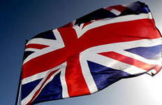
Politically marked ceremonies and parliamentary conventions

Slide 2
Ceremony
the ritual procedures observed at grand formal occasions.
For example:
the new Queen was proclaimed with due ceremony.

Slide 3
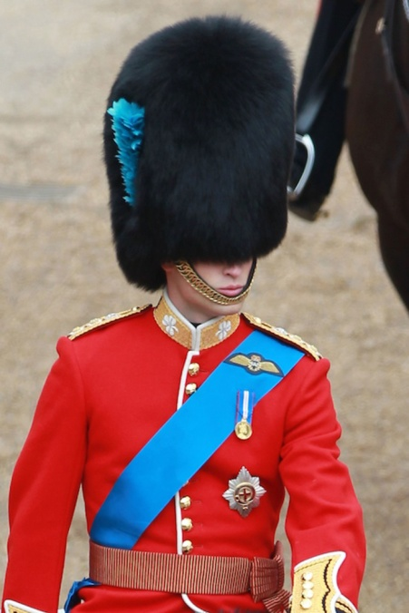
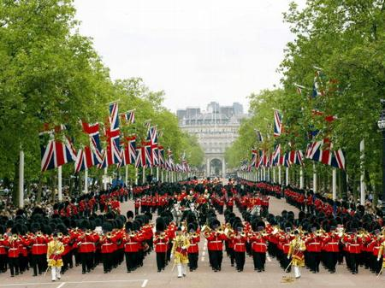
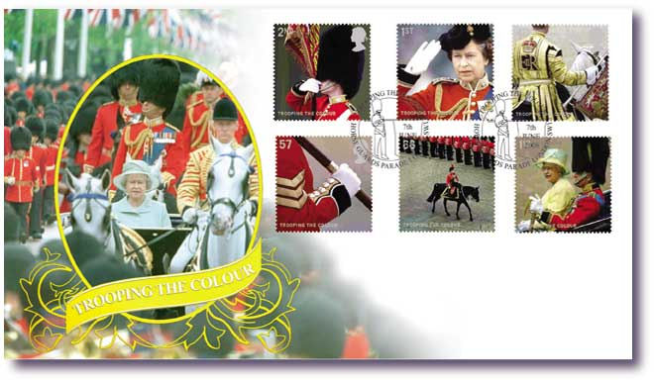
Trooping the Colour
is a ceremony performed by regiments of the British and Commonwealth armies.
is held annually on the reigning monarch’s “official” birthday, which is the second Saturday in June.
The ceremony stemmed from the need of soldiers to recognize the colours of their regiment in battle. The Parade is complex and precise and all seven regiments of the Household division take part, but only one colour is trooped each year.

Slide 4
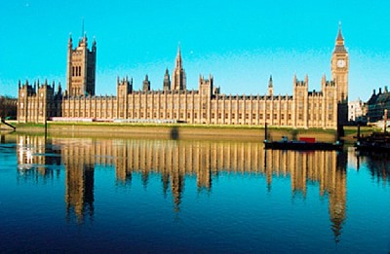
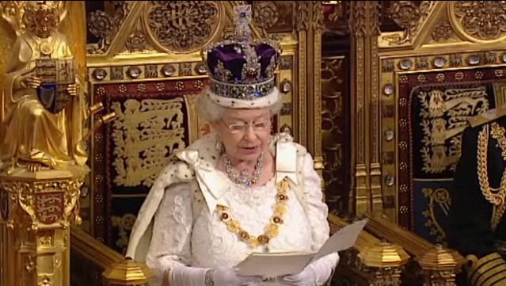
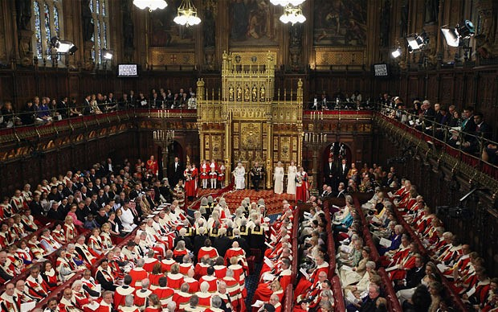
State Opening of Parliament
is an annual event held usually in October or November that marks the commencement of a session of Parliament .
includes a Speech from the Throne.
The State Opening of Parliament is a ceremony loaded with historical ritual and symbolic significance for the governance of the United Kingdom

Slide 5
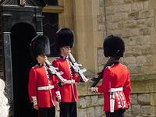
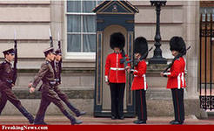
Changing the Guard.
The spectacular ceremony of Changing the Guard at Buckingham Palace attracts numerous spectators from the country and tourists from different parts of the world. The Guard is changed at 11.30 a.m. daily. It is formed from one of the regiments of Foot Guards. A band leads the new guard from Wellington or Chelsea barracks to the palace forecourt and after the ceremony it leads the old guard back to their barracks.

Slide 6
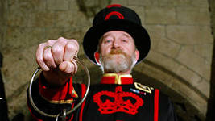
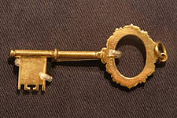
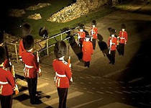
The Ceremony of the Keys
Every night at 9.53 p. m. the Chief Warder of the Yeomen Warders (Beefeaters) of the Tower of London lights a candle lantern and then makes his way towards the Bloody Tower. In the Archway his Escort await his arrival. The Chief Warder, carrying the keys, then moves off with his Escort to the West Gate, which he locks, while the Escort “present arms”. Then the Middle and Byward are locked.

Slide 7
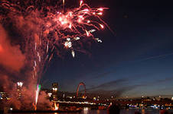
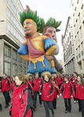
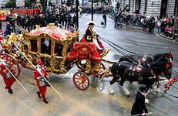
The Lord Mayor’s show
The Lord Mayor’s show is watched by many thousands of people, who throng the streets of the City of London to see this interesting procession and admire its glittering pageantry.
The ceremony is the gesture of pride in the City’s history and strength as a world commercial centre. The ceremony seems still more bright and colorful because it is always held on the second Saturday in November when the city is often wrapped in mist or rain.

Slide 8
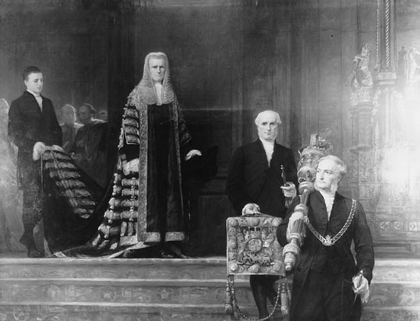
Lord Chancellor’s procession
The Lord Chancellor, accompanied by the mace and his attendants, makes his way through Prince’s Chamber and Royal Gallery to join the Lord Speaker in Sovereign’s Entrance.
Lord Chancellor and in former times Chancellor of England, is one of the most senior and important functionaries in the government of the United Kingdom. He is a Great Officer of State, and is appointed by the Sovereign on the advice of the Prime Minister.

Slide 9
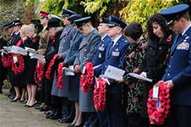
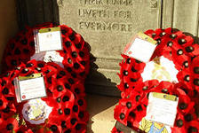
Remembrance Day
Remembrance Day is observed throughout Britain in commemoration of the million or more British soldiers and airmen who lost their lives during the two World Wars. On that day, the second Sunday in November, special services are held
The silence begins at the first stroke of Big Ben 11 o’clock, and is broken only by the crash of distant artillery and perhaps by the murmur of a passing jet. Members of the Royal Family or their representatives and political leaders come forward to lay wreaths at the foot of the Cenotaph. Then comes the march past the memorial of ex-servicemen and women, followed by an endless line of ordinary citizens who have come here with their personal wreaths and their sad memories.

Slide 10
The end

