Slide 1

Symbolic calendar days of rest and celebrations
Selivonchik Kseniya

Slide 2
holidays
1 (often holidays) an extended period of leisure and recreation, especially one spent away from home or in travelling:
I spent my summer holidays on a farm
Fred was on holiday in Spain
2 a day of festivity or recreation when no work is done:
25 December is an official public holiday
[as modifier] characteristic of a holiday; festive:
a holiday atmosphere
3 [with modifier] a short period during which the payment of instalments, tax, etc. may be suspended:
a pension holiday

Slide 3

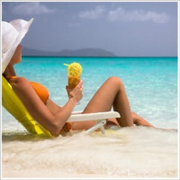

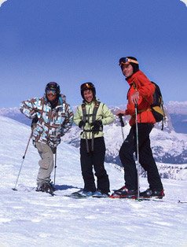

Slide 4
festival
1a day or period of celebration, typically for religious reasons:
traditional Jewish festivals
2an organized series of concerts, plays, or films, typically one held annually in the same place:
a major international festival of song

Slide 5
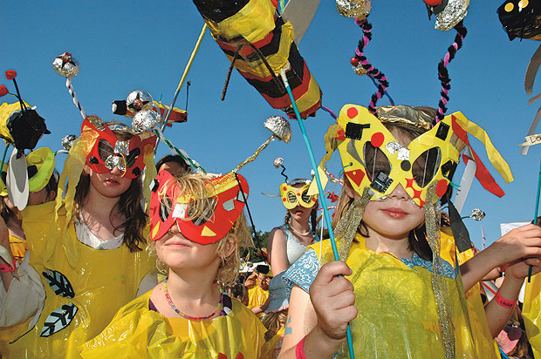
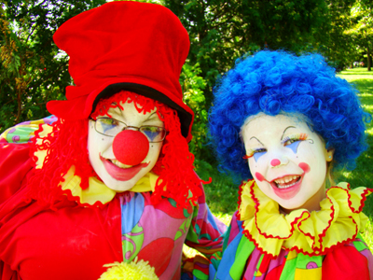
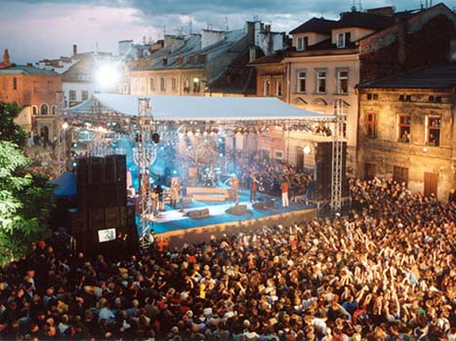

Slide 6

bank holiday
A day on which banks are legally closed.

Slide 7
public holiday
a day on which most of the shops/stores, businesses and schools in a country are closed, often to celebrate a particular event
a holiday observed over the whole country

Slide 8


Slide 9
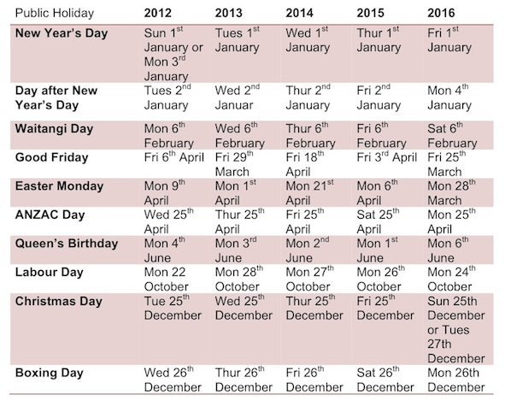

Slide 10
Constituent parts of national celebrations

Slide 11
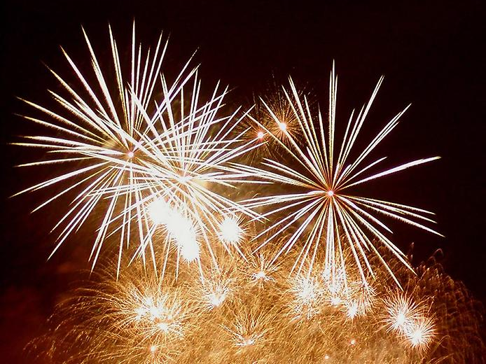
Fireworks

Slide 12
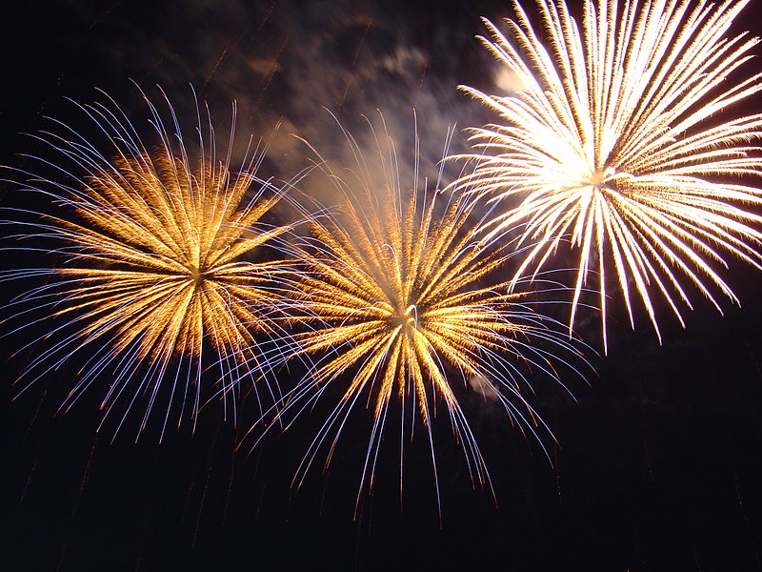
A firework is an explosive pyrotechnic device that is used mostly for entertainment. The most common use of a firework is as part of a fireworks display.
Fireworks are made to have these four effects:
They make noise, light, smoke, and sometimes produce floating materials (confetti for example). They may be designed to burn with colored flames and sparks. Fireworks are common throughout the world and are a main point of many different cultural and religious festivals. Independence Day and New Year's Eve are examples.

Slide 13
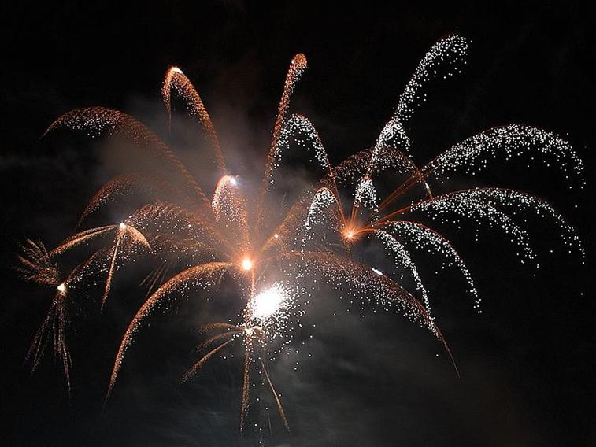
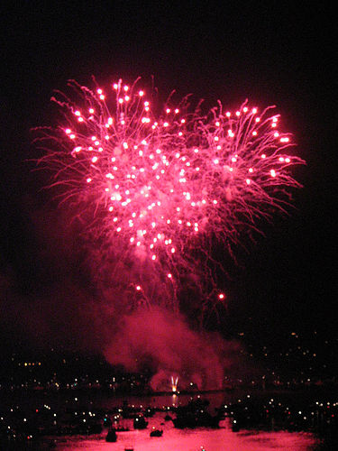
Types of Fireworks :

Slide 14
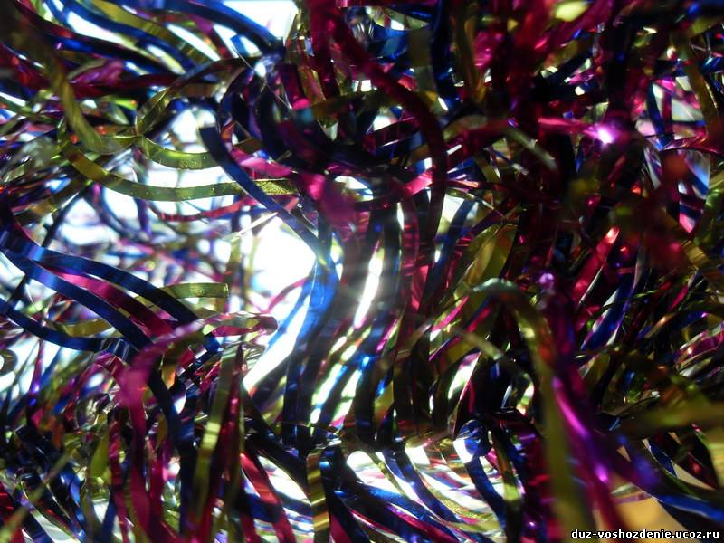
Paper streamer - a long strip of cloth or paper used for decoration or advertising

Slide 15
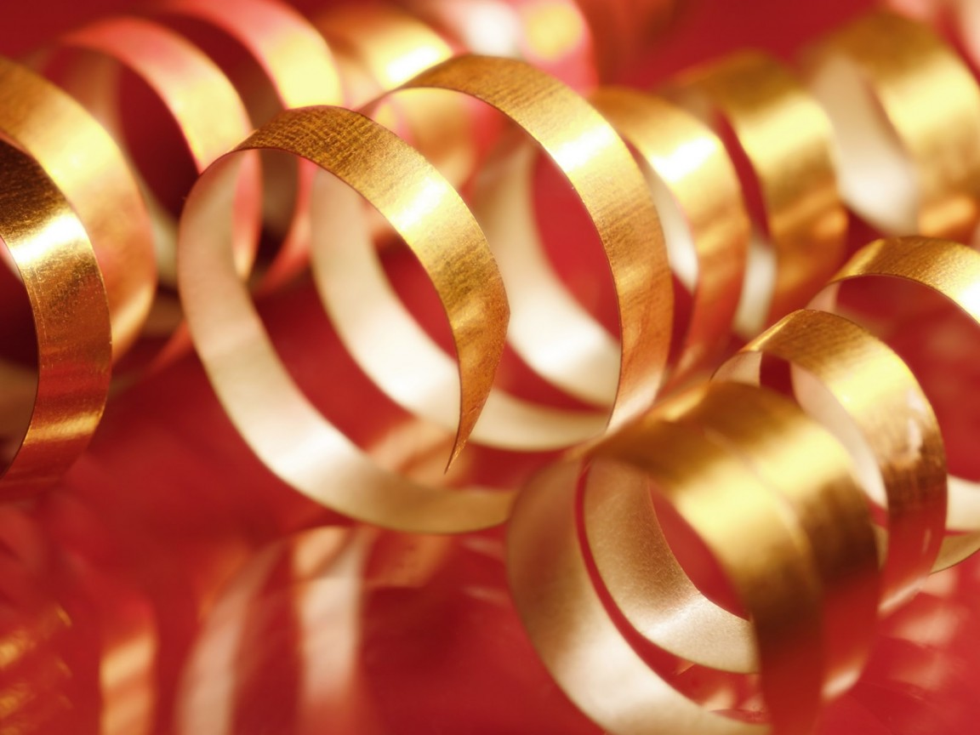
There's nothing like a great party or event, and there's nothing like the peak moment of those parties or events when all things culminate to an exciting conclusion and the sky rains down with streamers and confetti, offering a little something to take home as a souvenir, while leaving a smile that lingers. Whether after a big win at a sporting contest, a graduation, a birthday party, wedding or live event such as parade, concert or musical extravaganza, paper streamers falling from the sky offer the icing on the cake in terms of visual sense memory. Not only are paper streamers great in terms of look and effect, but they're also safe, soft and offer no real hazard as fireworks

Slide 16
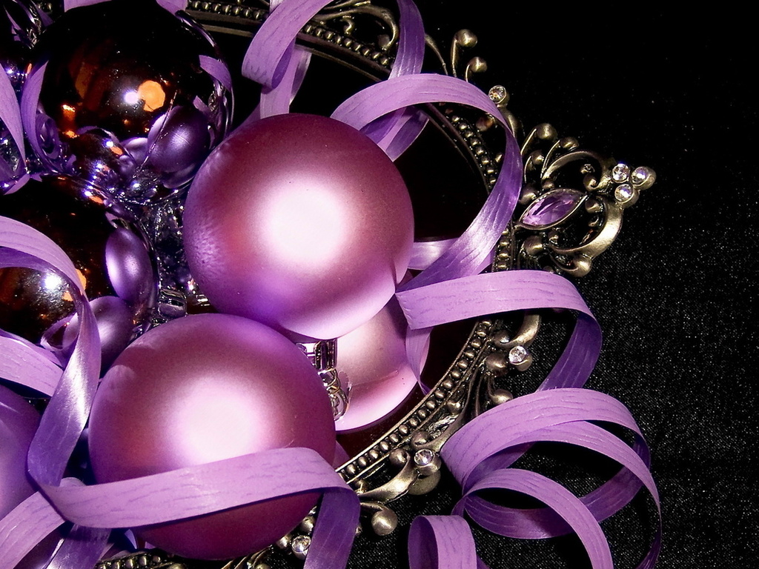

Slide 17
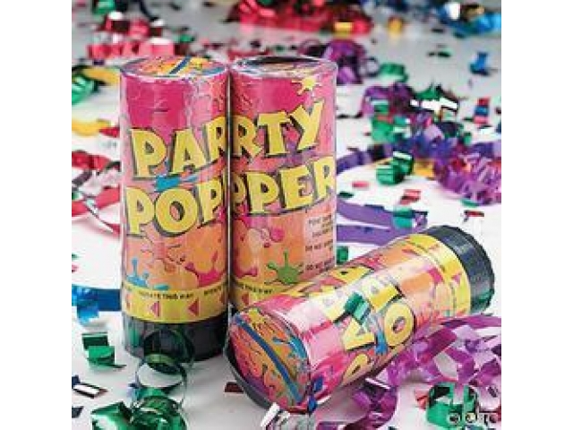
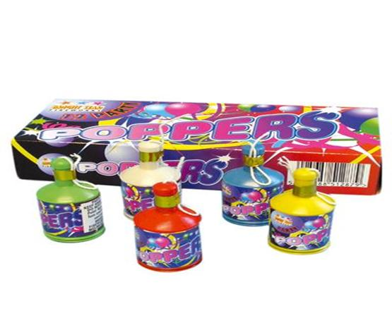
Party- poppers
A party popper is an object commonly used at parties. The charge or compressed air blows out some confetti or streamers and emits a popping sound.

Slide 18
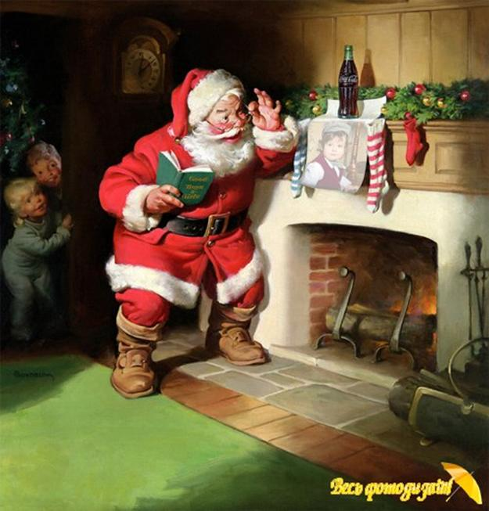
Santa Claus
Commonly associated with Christmas, Santa Claus is mostly shown as a fat and happy man wearing a red suit with white trim. According to the American version of the legend, Santa, as he is often known, lives in the North Pole with his wife, Mrs. Claus, some elves who build his toys, and reindeer who pull his sled.

Slide 19
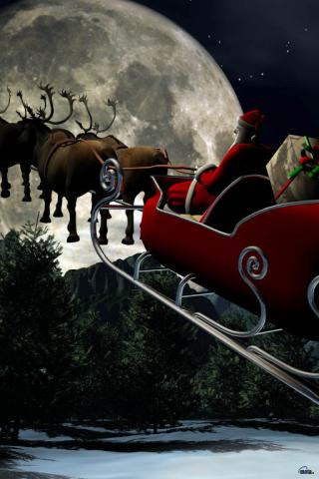
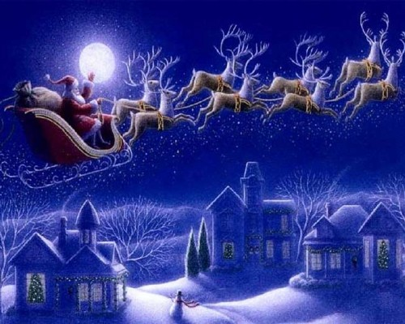
Santa Claus's reindeer
Santa Claus' reindeer is a team of flying reindeer traditionally held to pull the sleigh of Santa Claus and help him deliver Christmas gifts.

Slide 20
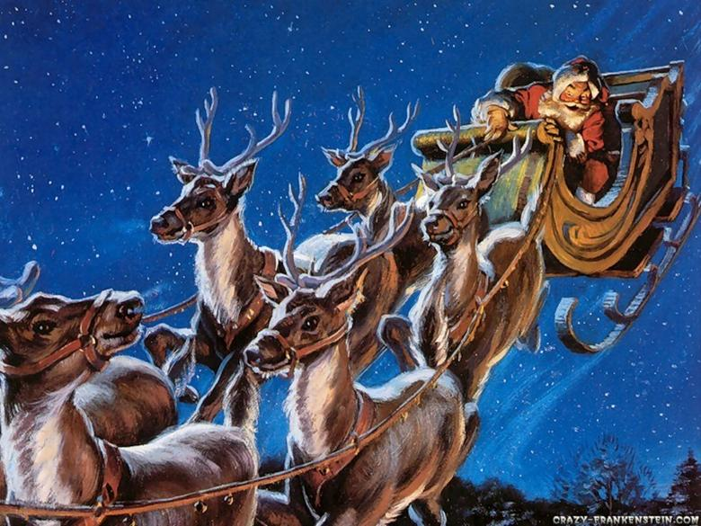
Santa Claus' sleigh is led by nine reindeer:
Dasher
Dancer
Prancer
Vixen
Comet
Cupid
Donner
Blitzen
Rudolph the Red-Nosed Reindeer

Slide 21
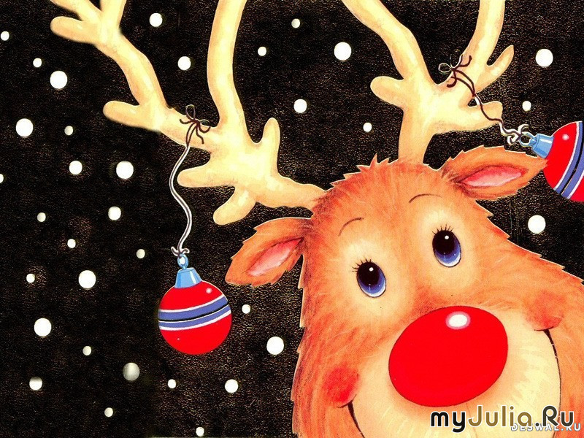
Rudolph (the red-nosed reindeer)

Slide 22
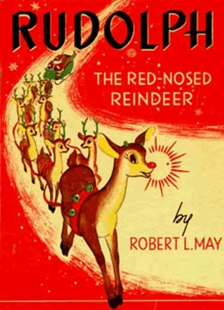
Rudolph's story was originally written in verse by Robert L. May for the Montgomery Ward chain of department stores in 1939, and published as a book to be given to children in the store at Christmas TIME.
According to this story, Rudolph's glowing red nose made him a social outcast among the other reindeer. However, one Christmas Eve Santa Claus was having a lot of difficulty making his flight around the world because it was too foggy. When Santa went to Rudolph's house to deliver his presents he noticed the glowing red nose in the darkened bedroom and decided it could be a makeshift lamp to guide his sleigh. He asked Rudolph to lead the sleigh for the rest of the night, Rudolph accepted and returned home a hero for having helped Santa Claus.

Slide 23
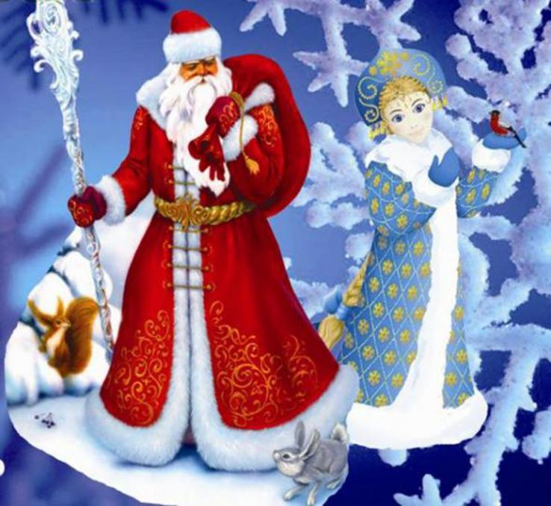
Father Frost
And
Snow Maiden
In Russia, Santa Claus is known as Father Frost. He is usually illustrated with his granddaughter, the snow maiden, Snegurochka riding with an evergreen tree and presents in a traditional Russian troika.

Slide 24
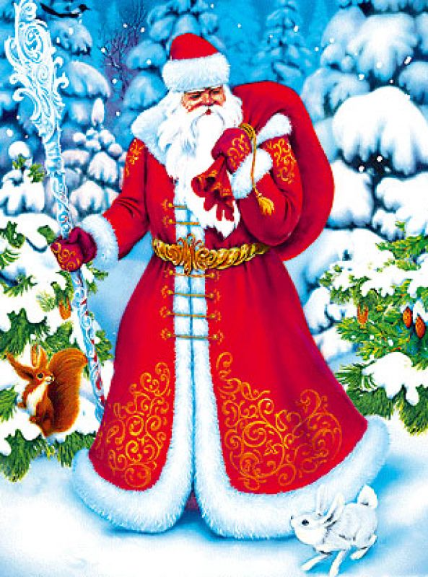
The original Russian gift-giver was Saint Nicholas.
Usually appearing as a tall, thin man with a long white beard, he often wore flowing robes of blue and white. He was said to have lived in the Russian woods and journeyed in a "troika," or sleigh drawn by three horses abreast.

Slide 25
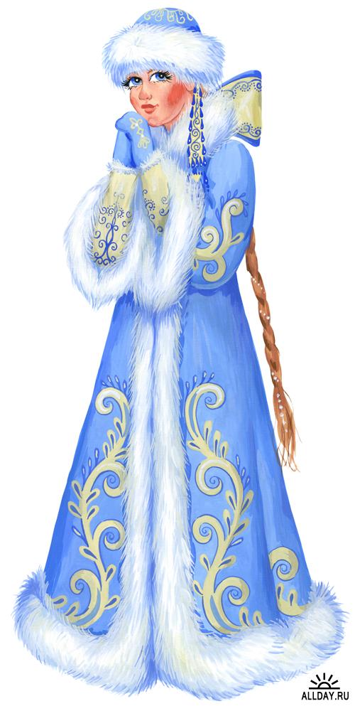
Snegurochka, the Snow Maiden (a character from a famous Russian fairy tale) was said to assist Ded Moroz in the delivery of his gifts to the Russian children. Later in the Twentieth Century, Snegurochka became known as Ded Moroz's granddaughter.

Slide 26
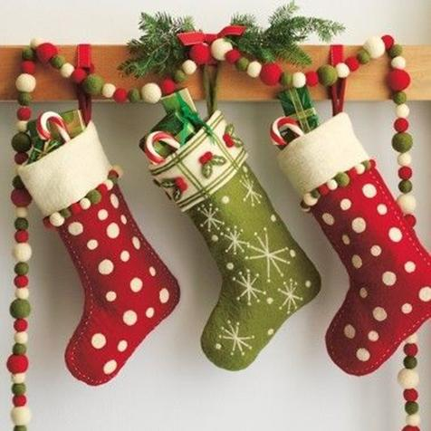
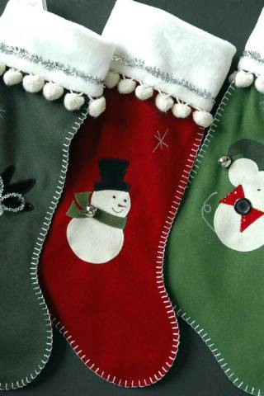
Stockings for presents
A Christmas stocking is a long sock hung by a fireplace or bed on Christmas Eve. Christmas presents are put into it for children. And it came from an old legend, which have now turned into a European tradition.

Slide 27
Very long ago, there lived a poor man and his three very beautiful daughters. He had no money to get his daughters married, and he was worried what would happen to them after his death.
Saint Nicholas was passing through when he heard the villagers talking about the girls. St. Nicholas wanted to help, but knew that the old man wouldn't accept charity. He decided to help in secret. He waited until it was night and crept through the chimney.
He had three bags of gold coins with him, one for each girl. As he was looking for a place to keep those three bags, he noticed stockings of the three girls that were hung over the mantelpiece for drying. He put one bag in each stocking and off he went. When the girls and their father woke up the next morning, they found the bags of gold coins and were of course, overjoyed. The girls were able to get married and live happily ever after.
This led to the custom of children hanging stockings or putting out shoes, eagerly awaiting gifts from Saint Nicholas.

Slide 28
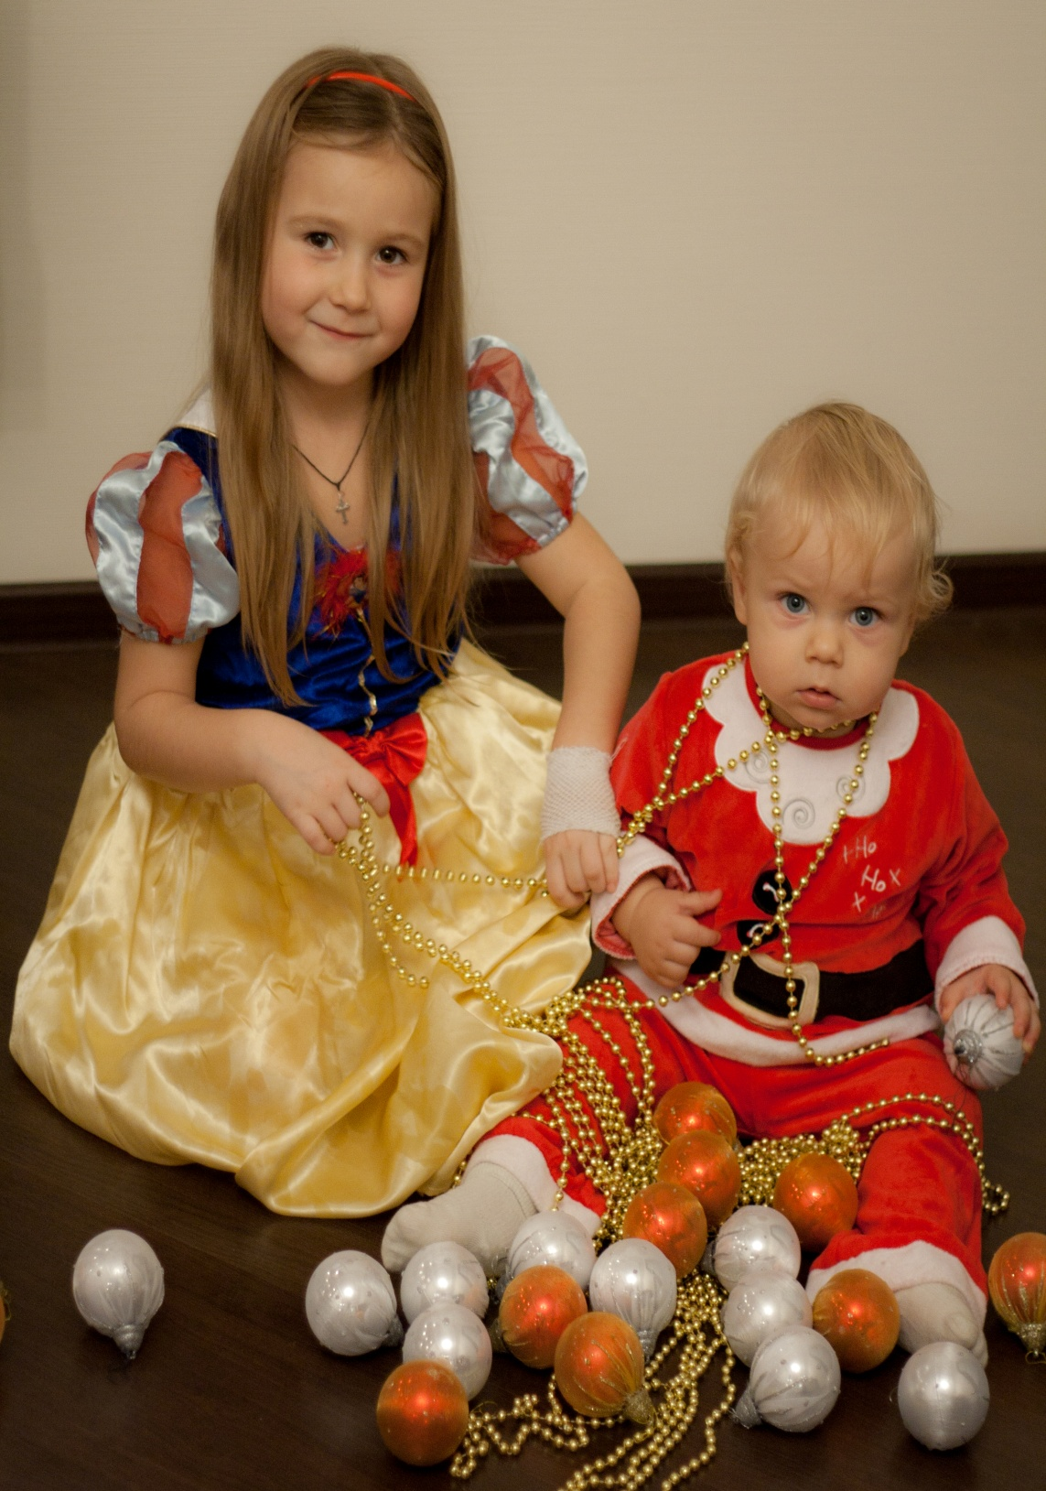
A fancy dress party
is a type of party where guests dress up in a costume.

Slide 29
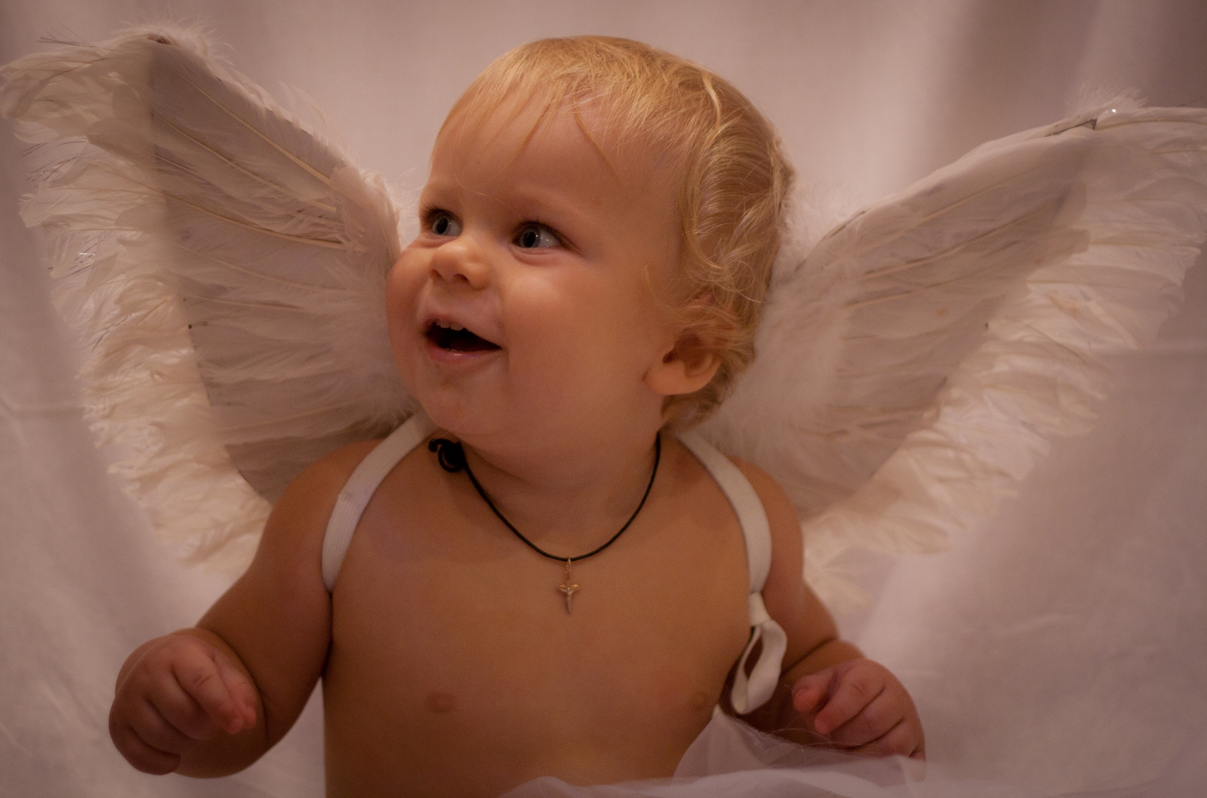

Slide 30
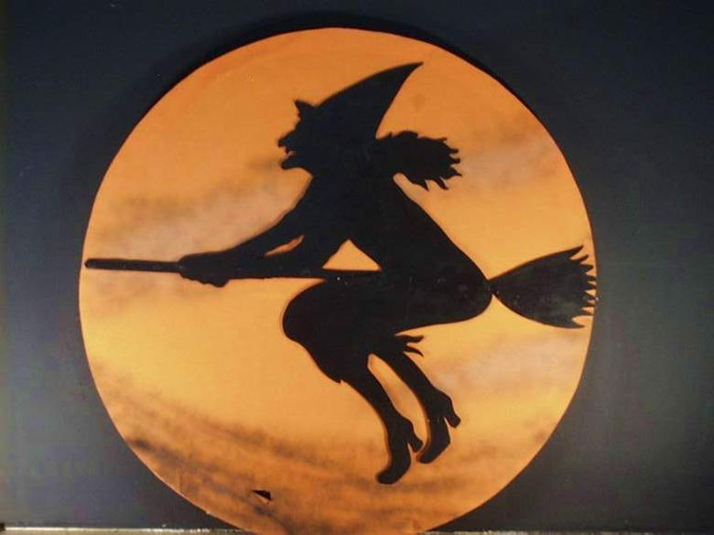
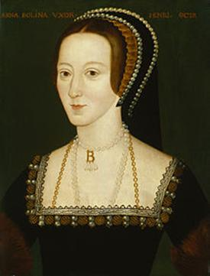
Witches
A witch is a person who practices witchcraft.
The stereotypical witches are commonly portrayed as wicked old women who have wrinkled skin, pimples, and pointy hats. They wear clothes that are black or purple. They also have warts on their noses and sometimes long claw-like fingernails.
Many Christians were scared of witches and witchcraft at that time. As a result, about sixty thousand people were tried for witchcraft, and executed. Most were hanged. Some were burned at the stake. Queen Anne Boleyn was accused of being a witch and was said to have had a large mole on her neck and a sixth finger, though this was likely invented by her enemies.

Slide 31
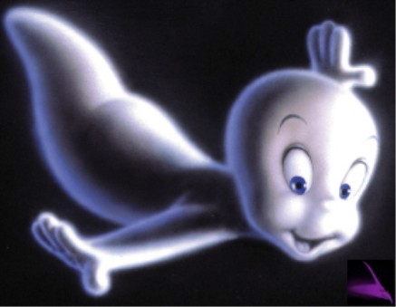
Ghosts
A ghost is considered to be the spirit of a dead person. Scientists say that there are no real ghosts, but many people believe that there are.
There are many stories about ghosts in books and movies. Sometimes the ghost is the spirit of a person who was killed or who died. The ghost may stay on Earth because he or she has unfinished problems or is still trying to say good bye to loved ones. Sometimes ghosts are said to live in a particular locality, for example an abandoned house.

Slide 32
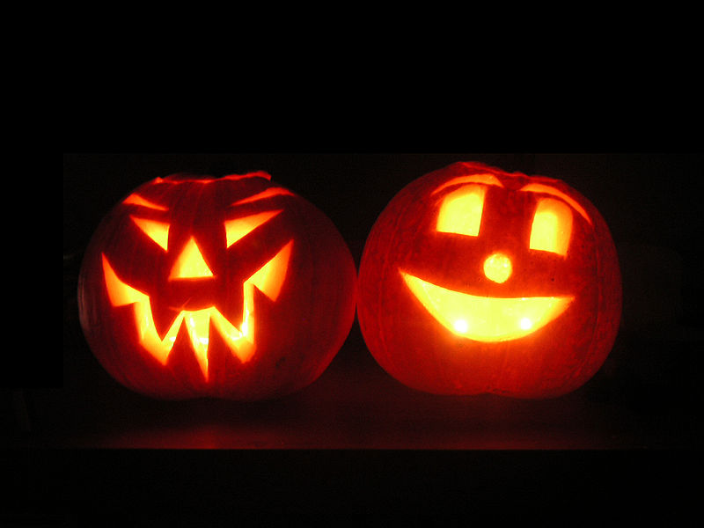
A modern jack-o'-lantern is a carved pumpkin, although originally large turnips were carved. It is associated chiefly with Halloween and was named after the phenomenon of strange light flickering over peat bogs, called jack-o'-lantern. In a jack-o'-lantern, the top is cut off, and the inside flesh then scooped out; an image, usually a monstrous face, is carved out, and the lid replaced
Jack-o-lanterns were also a way of protecting your home against the Undead.
Jack-o'-lantern

Slide 33
Politically marked ceremonies and parliamentary conventions

Slide 34
Britain is a royal state which has preserved its ceremonies and traditions over hundreds of years. Some are every day and some are every year. Many of them are world famous and attract numerous tourists from all over the world.

Slide 35
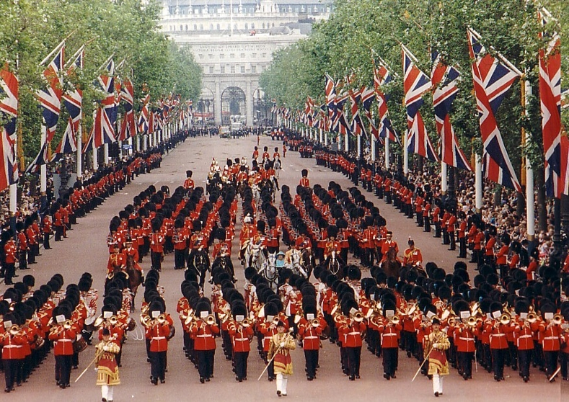
What is the Trooping the Colour?

Slide 36
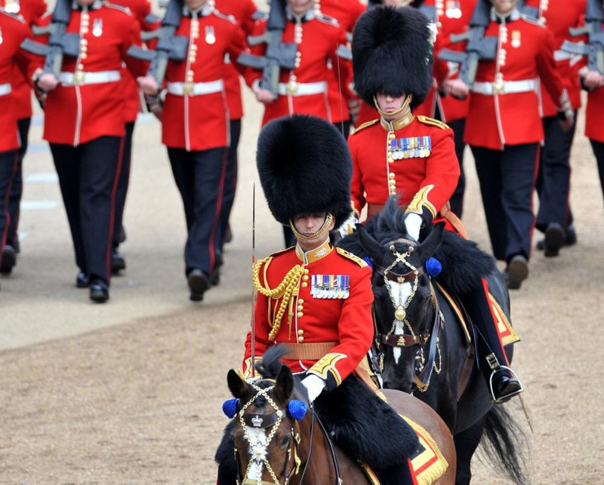

Slide 37
Trooping the Colour is a military ceremony performed by regiments of the Commonwealth and the British Army. It has been a tradition of British infantry regiments for centuries and it was first performed during the reign of Charles II.

Slide 38
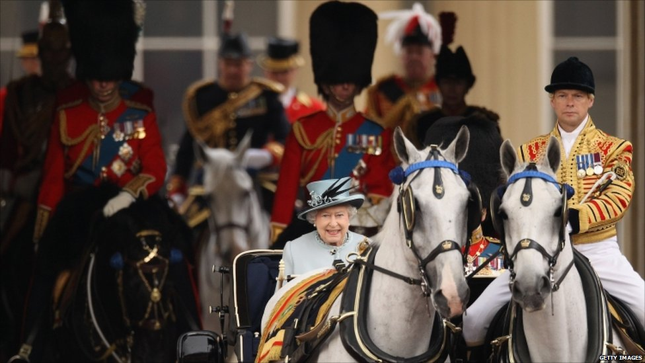
Since 1805 the ceremony has been carried out on the British Sovereign's birthday.

Slide 39
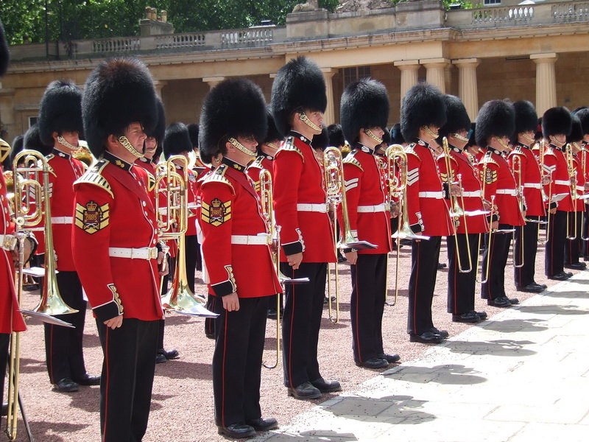

Slide 40
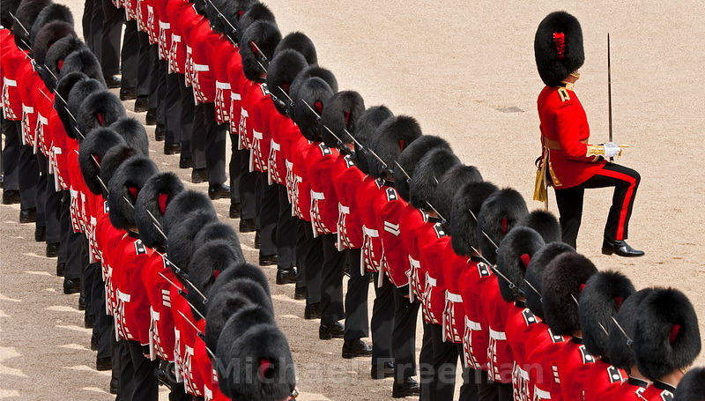
State Opening is the main ceremonial event of the parliamentary calendar, attracting large crowds, both in person and watching on television and the internet. The Queen's procession from Buckingham Palace to Westminster is escorted by the Household Cavalry.

Slide 41
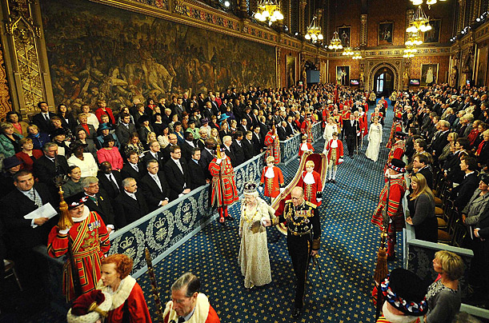
The State Opening of Parliament is the most colourful event of the Parliamentary year, which marks the beginning of the parliamentary session.

Slide 42
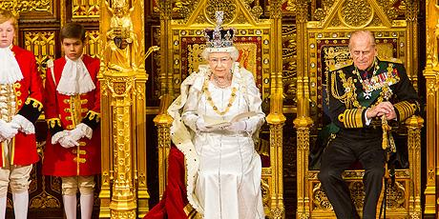
Its main purpose is for the monarch formally to open Parliament and, in the Queen's Speech, deliver an outline of the Government's proposed policies, legislation for the coming session and a review of the last session.

Slide 43
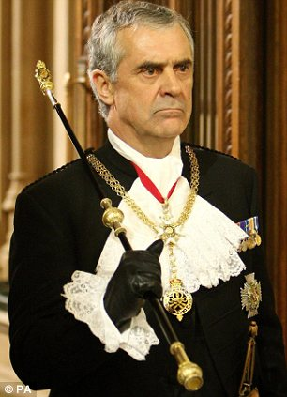
The official known as 'Black Rod‘ is sent to summon the Commons. In a symbol of the Commons' independence, the door to their chamber is slammed in Black Rod's face and not opened until Black Rod has knocked on the door with the staff of office. The Members of the House of Commons follow Black Rod and the Commons Speaker to the Lords Chamber and stand behind the Bar of the House of Lords ) to hear the Queen's Speech.

Slide 44
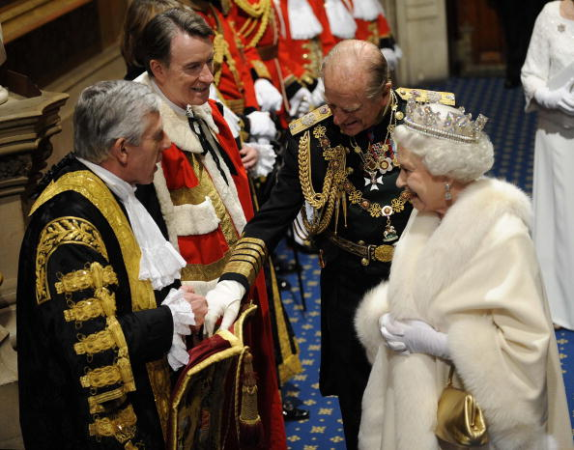
Traditions surrounding the State Opening and delivery of a speech by the monarch can be traced back at least to the 16th century.

Slide 45
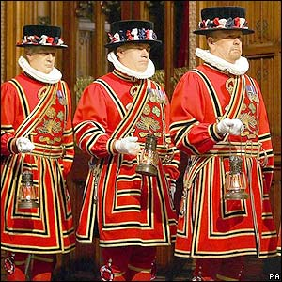
Before the opening of Parliament half a dozen "Beefeaters" the searching of the cellars underneath the Houses of Parliament, in memory of Guy Fawkes and the Gunpowder Plot in 1605.

Slide 46
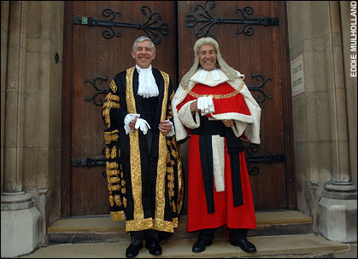
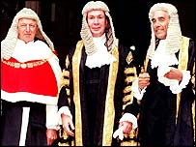
The Lord High Chancellor of Great Britain, or Lord Chancellor and in former times Chancellor of England, is one of the most senior and important functionaries in the government of the United Kingdom.

Slide 47
Before each day's sitting of the House of Lords, the Lord Chancellor forms part of a procession that marches from his residence to the Lords Chamber. The Lord Chancellor is preceded by the Deputy Serjeant-at-Arms or Principal Doorkeeper of the House and by the Purse-Bearer. The Lord Chancellor is followed by his Train-Bearer; the procession is later joined by the Gentleman Usher of the Black Rod. The Mace is placed on the Woolsack, where the Lord Chancellor sits after a bishop has led the House in prayers.

Slide 48
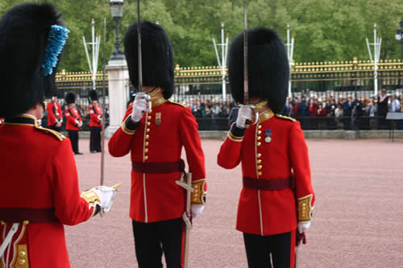
Changing the Guard or Guard Mounting is the process involving a new guard exchanging duty with the old guard.

Slide 49
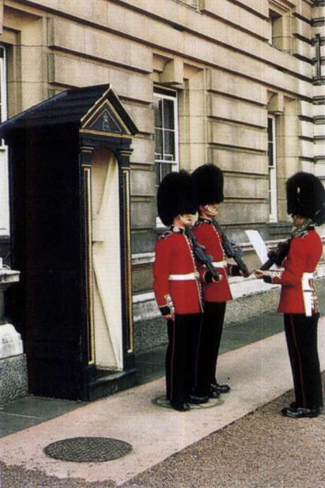
The changing of the guards takes place in the courtyard of Buckingham palace.
Briefly the procedure involves the new guard taking over duties from the old guard – however it is accompanied by lots of pomp, guards bands, military music and the ceremony of changing of the guard. The Queens guard provide a colourful display dressed in bearskins and red jackets.

Slide 50
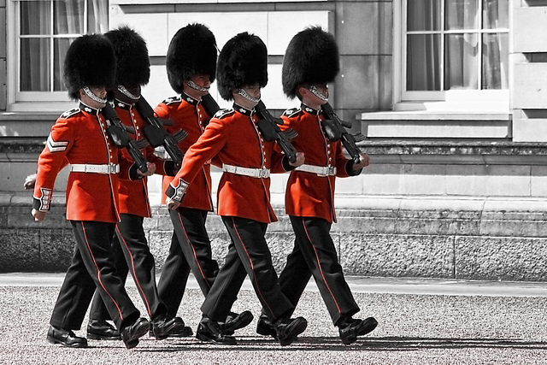

Slide 51
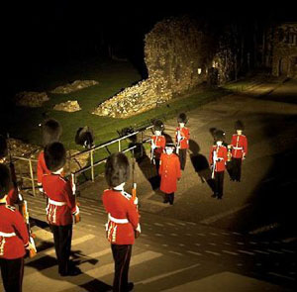
The Ceremony of the Keys

Slide 52
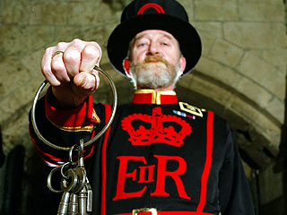
It takes place every night at the Tower of London, and has done so in some form or another since the 14th century.

Slide 53
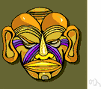


To mask-to cover with or put on a mask
To observe - to keep or celebrate (a holiday, for example): observe an anniversary

Slide 54

To celebrate – 1.to observe (a day or event) with ceremonies of respect, festivity, or rejoicing.
2. To perform (a religious ceremony): celebrate Mass.
To commemorate - to honor the memory of with a ceremony.

Slide 55

To honour – 1.to hold in respect or esteem
2. show respect towards; "honour your parents!"
To keep (to preserve) a tradition – to follow, to observe a tradition

Slide 56

To organize a parade-(a demonstration) to put together into an orderly, functional, structured whole.
To hold a parade – to support, to direct a parade to sponsor a parade – support a parade materially or financially a parade - an organized public procession on a festive or ceremonial occasion

Slide 57

To give a party (to throw a party) - to have a party; to hold a party; to arrange a party.
Bill threw a party for his sister before she went away to college.

Slide 58
Activities in observance of holidays:Part II

Slide 59
To have family get together-to gather members of the family in one place for a common purpose.

Slide 60


Slide 61


Slide 62

Merry-making is the activities of people who are enjoying themselves together in a lively way, for example by eating, drinking, or dancing, a time of feasting and visiting friends.
Merry-making is the activities of people who are enjoying themselves together in a lively way, for example by eating, drinking, or dancing. ...a time of merry-making, feasting and visiting friends.

Slide 63




Slide 64
To give presents or gifts – to give services or goods voluntarily without payment in return, as to show favor toward someone, honor an occasion, or make a gesture of assistance.

Slide 65





Slide 66
To send greeting cards (Valentine cards)- to send decorative cards to convey good wishes on some occasion.

Slide 67






Slide 68







Valentine cards

Slide 69
To go treat or tricking is a customary practice for children on Halloween in many countries. Children in costumes travel from house to house in order to ask for treats such as candy (or, in some cultures, money) with the question "Trick or treat?". The "trick" is a (usually idle) threat to perform mischief on the homeowners or their property if no treat is given.

Slide 70






Slide 71
To ask a penny for the guy - It is a phrase used by children on Guy Fawkes night, November 5th in Britain. "Penny for the Guy" is used as a way of asking for money when bringing around an effigy of Guy Fawkes. They would make something like a scarecrow and then wheel him around on a wheelbarrow or trolley or pram or by some other means, and go collecting money.

Slide 72





Slide 73
To have bonfires – people have bonfires at Bonfire Night which is celebrated all over the UK.
Every year on 5th November, the anniversary of the Gunpowder Plot, Guy Fawkes is remembered.
Throughout England, towns and villages....
light huge bonfires,
let off magnificent fireworks,
burn an effigy (a homemade model of a man, like a scarecrow) and
celebrate the fact the Parliament and James I were not blown sky high by Guy Fawkes.

Slide 74





Slide 75
To lay wreaths - the gift of flowers at a memorial site is a ritual that occurs around the world. The floral tributes at funerals bespeak both the beauty and the brevity of life and evoke memories of other days.

Slide 76





Slide 77
Constituent Parts Of National Celebrations

Slide 78

New Year Tree Decoration: New Year tree is a very important part of New Year decorations. There are a number of choices, when it comes to choosing a New Year tree, but the best New Year tree can be made of fir tree. You can choose an original or an artificial fir tree. You can decorate the tree with a number of accessories such as baubles, lights,garlands, and ribbons. You also can decorate the tree with fresh and original fruits. Some fruits like apples, lemons, oranges, and pears can be great decorative element for the New Year tree.

Slide 79


Slide 80



Christmas ornaments are decorations (usually made of glass, metal, wood or ceramics) that are used to festoon a Christmas tree. Ornaments take many different forms, from a simple round ball to highly artistic designs. Ornaments are almost always reused year after year, rather than purchased annually, and family collections often contain a combination of commercially produced ornaments and decorations created by family members. Such collections are often passed on and augmented from generation to generation.
Santa Claus is a commonly used figure. Candy canes, fruit, animals, snowmen, angels and snowflake imagery are also popular choices.

Slide 82


Slide 83

A bauble is a spherical decoration that is commonly used to adorn Christmas trees. The bauble is one of the most popular Christmas ornament designs, and they have been in production since 1847. Baubles can have various designs on them, from "baby's first Christmas," to a favorite sports team. Many are plain, being simply a shiny sphere of a single color.
The first decorated trees were adorned with apples, strings of popcorn, white candy canes and pastries in the shapes of stars, hearts and flowers. Glass baubles were first made in Lauscha, Germany, by Hans Greiner who produced garlands of glass beads similar to the popcorn strands and tin figures that could be hung on trees.

Slide 84


Slide 85


Slide 86

Glitter describes an assortment of very small, flat, and reflective particles. When these particles are applied to surfaces, they each reflect light in different angles causing the surface to sparkle or glitter. Glitter is similar to, but smaller than confetti or sequins. Glitter has been produced and used decoratively since prehistoric times from many different materials including mica insects, glass, and now plastic.

Slide 87

The first production of modern glitter has been sometimes been credited to American cattle farmer and machinist, Henry Ruschmann, shortly after the start of WWII. With German glass glitter unavailable due to the war, Ruschmann found a market for scrap material ground into glitter made of plastics. He founded Meadowbrook Inventions, Inc. in Bernardsville New Jersey, and the company is still a major producer of industrial glitter today.

Slide 88

Over 60,000 years ago, the ancient Egyptians produced glittering cosmetics from the iridescent shells of beetles as well as finely green malachite crystal. Prior to modern plastics, particles of glass were used to create glittering surfaces and glass glitter is still produced commercially.

Slide 89

Evergreen Trees - Pine, Fir, Holly, Ivy - have a deep symbolic meaning connected with Christianity and Christmas. Just like these trees always remain green - Jesus also promises a never ending life in God.
Evergreen Trees and decorations based on these trees have been used for centuries, for Christmas Decor. Apart from symbolizing God's endless love and mercy, they also complement the red and white colors of Christmas Decor really well.

Slide 90

Stars, wreaths, and ropes of evergreen and holly adorn the interior of many homes each holiday season. There is no necessity for festooning a room with garland and wreaths in the same way year after year. A unique Christmas decorating project is composed simply of ropes of evergreen fastened to a curtain pole, hung in an interior doorway or large window.

Slide 91


Slide 92

A garland is a decorative wreath or cord, used at festive occasions, which can be hung round a person's neck, or on inanimate objects like Christmas trees. Originally garlands were made of flowers or leaves.

Slide 93


Slide 94

The use of mistletoe as a decoration has roots in both pagan and Christian traditions. In pagan customs, enemies who met under mistletoe were required to lay down their weapons and maintain a truce until the next day. To kiss under it was to bring fertility to the kissers.
In Christianity, mistletoe sprang into use in England during the middle ages. A ring of flexible wood (for example, willow) was entwined with evergreens of holly, bay, rosemary or yew. In the middle of this ring was placed a baby Jesus on a bed of moss. The rest of the ring was decorated with ribbons, nuts, fruits and mistletoe. As guests visited the house, they were kissed under the Holly Bough as a sign of goodwill and all bad feelings were forgiven and forgotten.

Slide 95

The custom of kissing under it also survived. Eventually mistletoe was solely used. During Queen Victoria's reign, every time a kiss was stolen under the mistletoe, one of its berries was removed. When all the berries were gone, no more kisses could be shared.
As a Christmas decoration, mistletoe continues to be extremely popular. Hang it by the front door or from door frames. Add it to garland. Decorate the base of candle holders with it.

Slide 96
A great accent decoration
Holly is another Christmas decoration with pagan roots. In Celtic mythology, winter and summer were represented by twin kings, the "Holly King" (winter) and the "Oak King" (summer). During autumn and early winter, the Holly King reigned supreme. The holly trees were the only greenery left in the bare forest. His twin, the Oak King, having lost his leaves, was "naked" and therefore defeated. It is during this time that the days get shorter and shorter. However, during the Winter Solstice, the shortest day of the year, the balance of power between the twins starts to shift. Once this day passes, the days begin to grow longer, gaining more light. Then it's the Oak King who reigns, only to be supplanted by his brother during the Summer Solstice. To the ancient Celts, this changing of the seasons was symbolic of the cycle of life, birth and death. Therefore holly was symbolic of life and spring to come.

Slide 97

Holly has since become synonymous with Christmas, as apparent with Christmas carols such as "Deck the Halls with Boughs of Holly" and "The Holly and the Ivy". On Christmas cards, table clothes and even clothing, holly is a common site during the holidays.
Holly is the perfect and versatile accent to compliment other decorations. Added to garlands it provides a burst of red and makes a long-lasting wreath. Tie to the door knocker to ward off bad luck (an old Celtic tradition). Place it in bowls mixed with red and green Christmas ornaments. Place a sprig of holly beside each place setting at the dinner table.

Slide 98

Fireworks are a class of explosive pyrotechnic devices used for aesthetic and entertainment, and religious purposes. The most common use of a firework is as part of a fireworks display Fireworks competitions are also regularly held at a number of places. They may be designed to burn with flames and sparks of many colors, typically red, orange, yellow, green, blue, purple, and silver. Displays are common throughout the world and are the focal point of many cultural and celebrations.

Slide 99

The earliest documentation of fireworks dates back to 7th century China, where they were invented. The fireworks were used to accompany many festivities. It is a part of the culture of China and had its origin there; eventually it spread to other cultures and societies.

Slide 100
The Advent wreath is a circular garland of evergreen branches representing eternity. On that wreath, five candles are typically arranged. During the season of Advent one candle on the wreath is lit each Sunday as a part of the Advent services. Each candle represents an aspect of the spiritual preparation for the coming of the Lord, Jesus Christ.
Set on the branches of the wreath are four candles: three purple candles and one pink candle. In the center of the wreath sits a white candle. As a whole, these candles represent the coming of the light of Christ into the world.
On the first Sunday of Advent, the first purple candle is lit. This candle is typically called the "Prophecy Candle" in remembrance of the prophets, primarily Isaiah, who foretold the birth of Christ. This candle represents hope or expectation in anticipation of the coming Messiah.
Each week on Sunday, an additional candle is lit. On the second Sunday of Advent, the second purple candle is lit. This candle typically represents love. Some traditions call this the "Bethlehem Candle," symbolizing Christ's manger.
On the third Sunday of Advent the pink, or rose-colored candle is lit. This pink candle is customarily called the "Shepherds Candle" and it represents joy.
The fourth and last purple candle, oftentimes called the "Angels Candle," represents peace and is lit on the fourth Sunday of Advent.

Slide 101


Slide 102

Christmas Lights
The world glows with a colorful light at one time of the year - Christmas. Everywhere you look, Christmas lights sparkle and brighten every door step, window, and Christmas tree. The red, green, and white glow of Christmas lights not only light up the cold winter landscape, they ignite the Christmas spirit within us all.

Slide 103

Since the 17th Century, people have lit their Christmas trees to sit by its comforting glow. The families of Christmas past attached Christmas candles to the ends of the tree's branches using wax or pins. In 1879, Thomas Edison invented the first practical light bulb; but it wasn't until 1882 when Edward Johnson, an associate of Edison 's, created the first string of Christmas lights by hand wiring 80 red, white, and blue bulbs together in a string.

Slide 104


Slide 105


Slide 106





Best gifts & their history

Slide 107



Toys

Slide 108





Dolls

Slide 109


Building blocks

Slide 110




Teddy bears

Slide 111





Boxes of sweets & biscuits

Slide 112






Chocolate & Easter eggs

Slide 113




Sugar mice

Slide 114

Red roses

Slide 115
Sweet holidays!

Slide 116
Special celebration foods

Slide 117

Christmas turkey
Christmas turkey is a popular entree for Christmas dinner. Filled with a variety of stuffing, it is usually the centerpiece at the Christmas table.

Slide 118


Slide 119





Slide 120
Recipe
Ingredients:
• 1 turkey with the giblets removed
• 100g of butter
• 1 sliced lemon
• 6 bay leaves
Directions:
First pre heat the oven to 190 degree Celsius. Soften 100g of butter in a bowl at room temperature. Put your fingers under the turkey breast to loosen it. Spread the softened butter under the skin of the turkey, lay the sliced lemon under the skin along with the bay leaves and cover the turkey in a foil. Roast it and before the 30 minutes of the cooking time ends, remove the foil and cut the remaining 2 lemons in half and roast it again for another 30 minutes. Allow the Turkey to stand for 15-20 minutes before you carve.

Slide 121


Slide 122
The Christmas pudding
Christmas pudding is a type of pudding traditionally served on Christmas Day. It has its origins in medieval England, and is sometimes known as plum pudding or plum duff, though this can also refer to other kinds of boiled pudding involving dried fruit. Despite popular belief, Christmas puddings must always contain actual plum flesh to be called a plum pudding.

Slide 123



The Christmas pudding

Slide 124

Recipe
Ingredients:
For the pudding
50g blanched almonds
2 large Bramley cooking apples
200g box candied peel (in large pieces) or all citron if you can find it
1 whole nutmeg (you'll use three quarters of it)
1kg raisins
140g plain flour
100g soft fresh white breadcrumbs
100g light muscovado sugar , crumbled if it looks lumpy
3 large eggs
2 tbsp brandy or cognac, plus extra to flame
250g packet butter , taken straight from the fridge

Slide 125


Slide 126


Chocolate log
Chocolate log is a
chocolate cake eaten
at Christmas.

Slide 127
Recipe
Ingredients:
For the sponge:
4 eggs
125 g sugar
125 g self-raising flour
For the buttercream:
100 ml water
20 g caster sugar
2 egg whites
400 g butter, softened
200 g dark chocolate, melted in a bowl suspended over a pan of simmering water
To garnish:
2 sprigs mint leaves
1 handfuls mixed berries
1 dashes of icing sugar

Slide 128





Slide 129
Mulled wine
Mulled wine (otherwise known as Glögg or Gløgg) is a beverage that ranges from alcoholic to non-alcoholic. Mulled wine is usually made with red wine along with spices and raisins, served hot or warm. It is a traditional drink during winter, especially around Christmas and Halloween.
Port and claret are popular choices for mulled wine.
An easy mulled wine recipe for the festive season, brimming with Christmassy spice and a kick of sloe gin.

Slide 130

Ingredients:
1 bottle red wine
60g/2oz demerara sugar
1 cinnamon stick
grated nutmeg
1 orange, halved
1 dried bay leaf
60ml/2fl oz sloe or damson gin (optional)
Preparation method:
1. Put the wine in a saucepan with the orange, sugar, bayleaf and the spices.
2. Heat gently until the sugar has dissolved. Taste to see if you want the wine sweeter, and add more sugar to taste.
3. Off the heat, stir in the sloe or damson gin if you are using it.
4. Strain into heatproof glasses and serve at once.

Slide 131





Slide 132
Mince pie
A mince pie, also known as minced pie, is a small British sweet pie traditionally served during the Christmas season. Its ingredients are traceable to the 13th century, when returning European crusaders brought with them Middle Eastern recipes containing meats, fruits and spices.
The early mince pie was known by several names, including mutton pie, shrid pie and Christmas pie. Typically its ingredients were a mixture of minced meat, suet, a range of fruits, and spices such as cinnamon, cloves and nutmeg. Served around Christmas, the savoury Christmas pie (as it became known) was associated with supposed Catholic "idolatry" and during the English Civil War was frowned on by the Puritan authorities. Nevertheless, the tradition of eating Christmas pie in December continued through to the Victorian era, although by then its recipe had become sweeter and its size reduced markedly from the large oblong shape once observed. Today the mince pie remains a popular seasonal treat enjoyed by many across the United Kingdom.

Slide 133


Slide 134



Ingredients:
350g/12oz high quality mincemeat, preferably homemade
200g/7oz plain flour, sifted
40g/1½oz golden caster sugar
75g/2¾oz ground almonds
125g/4½oz unsalted butter, diced
1 large free-range egg, beaten
milk, to glaze

Slide 135
Cake
Cake is a form of bread or bread-like food. In its modern forms, it is typically a sweet baked dessert. In its oldest forms, cakes were normally fried breads or cheesecakes, and normally had a disk shape. Determining whether a given food should be classified as bread, cake, or pastry can be difficult.
Modern cake, especially layer cakes, normally contain a combination of flour, sugar, eggs, and butter or oil, with some varieties also requiring liquid (typically milk or water) and leavening agents (such as yeast or baking powder). Flavorful ingredients like fruit purées, nuts, dried or candied fruit, or extracts are often added, and numerous substitutions for the primary ingredients are possible. Cakes are often filled with fruit preserves or dessert sauces (like pastry cream), iced with buttercream or other icings, and decorated with marzipan, piped borders or candied fruit.
Cake is often the dessert of choice for meals at ceremonial occasions, particularly weddings, anniversaries, and birthdays. There are countless cake recipes; some are bread-like, some rich and elaborate, and many are centuries old. Cake making is no longer a complicated procedure; while at one time considerable labor went into cake making (particularly the whisking of egg foams), baking equipment and directions have been simplified so that even the most amateur cook may bake a cake.

Slide 136





Slide 137
Almond Cake With Berry Sauce
Ingredients:
3/4 cup sugar
1/2 cup unsalted butter, room temperature
8 ounces almond paste
3 eggs
1 tablespoon Amaretto
1/4 teaspoon almond extract
1/4 cup all-purpose flour
1/2 teaspoon baking powder
powdered sugar
Raspberry Sauce or Blueberry Sauce

Slide 138
Preparation:
Combine sugar, butter and almond paste, blending well; beat in eggs, Amaretto, and almond extract. Gently stir in flour and baking powder, mixing just until blended. Pour batter into a greased and floured 8-inch round cake pan. Bake at 350° for 40 to 50 minutes,or until a wooden pick or cake tester inserted in center comes out clean. Invert onto a cake plate and sprinkle with powdered sugar. Make Berry Sauce or the Blueberry Sauce.

Slide 139

Raspberry Sauce:
2 cups fresh or 1 (12-ounce) package whole frozen red raspberries (or strawberries)
2 tablespoons sugar, or to taste
Combine sauce ingredients in a blender container and purée. Press through a sieve to remove seeds. Serve sauce over cake.
Fresh Blueberry Sauce:
2 cups fresh blueberries
1/3 cup sugar
1 tablespoon fresh lemon juice
1/4 teaspoon salt
1/2 teaspoon vanilla extract
Wash and crush blueberries; add sugar, lemon juice and salt. Mix well. In a small saucepan, bring blueberry mixture to a boil; boil 1 minute. Add vanilla. Chill. Serve over puddings, cake, or ice cream.

Slide 140
Easter eggs
Easter eggs are special eggs that are often given to celebrate Easter or springtime. Easter eggs are common during Eastertide as they symbolize the empty tomb of Jesus. Though an egg appears to be like the stone of a tomb, a bird hatches from it with life; similarly, the Easter egg, for Christians, is a reminder that Jesus rose from the grave, and that those who believe will also experience eternal life.

Slide 141


Slide 142
Recipe
Ingredients:
Easter Eggs (see Vanilla Variation):
1/3 cup butter or margarine
1 package (about 3 ounces, 4 servings) chocolate pudding and pie filling mix (not instant)
1/4 cup milk
1/8 teaspoon almond extract
1-3/4 cups powdered sugar
1/2 cup finely ground blanched almonds

Slide 143






Slide 144
The Thanksgiving turkey
Thanksgiving Day falls on the third Thursday in the month of November and every American family cooks a hearty dinner to celebrate the occasion. There are any amount of turkey recipes for thanksgiving but many people love the traditional roast turkey dinner.
Thanksgiving wouldn’t be the same without the large roast turkey accompanied by some of the most popular autumn vegetables. Hosting a Thanksgiving dinner can be nerve wracking and many amateur cooks look out for tried and tested turkey recipes for thanksgiving. A twelve pound turkey should render ten to twelve hearty portions and a fresh bird always seems to taste a little better than a frozen one.

Slide 145

INGREDIENTS:
One twelve pound turkey-fresh if possible
Salt
Black pepper
A handful of fresh parsley
A few sprigs of fresh Thyme
One medium sized onion
A half a cup of salted butter
Olive oil
A length of string
Tinfoil

Slide 146





Slide 147
Pumpkin pie
Pumpkin pie is a traditional sweet dessert, often eaten during the fall and early winter, especially for Thanksgiving and Christmas in the United States and Canada. The pumpkin is a symbol of harvest time and featured also at Halloween.
The pie consists of a pumpkin-based custard, ranging in color from orange to brown, baked in a single pie shell, rarely with a top crust. The pie is generally flavored with nutmeg, cinnamon, cloves, and ginger.
This pie is often made from canned pumpkin or packaged pumpkin pie filling (spices included); this is a seasonal product available in bakeries and grocery stores, although it is possible to find year-round.

Slide 148


Slide 149
Recipe
Ingredients:
1 medium sugar pumpkin
1 tablespoon vegetable oil
1 recipe pastry for a 9 inch single crust pie
1/2 teaspoon ground ginger
1/2 teaspoon ground cinnamon
1 teaspoon salt
4 eggs, lightly beaten
1 cup honey, warmed slightly
1/2 cup milk
1/2 cup heavy whipping cream
Directions:
Cut pumpkin in half, and remove seeds. Lightly oil the cut surface. Place cut side down on a jelly roll pan lined with foil and lightly oiled. Bake at 325 degrees F (165 degrees C) until the flesh is tender when poked with a fork. Cool until just warm. Scrape the pumpkin flesh from the peel. Either mash, or puree in small batches in a blender.
In large bowl, blend together 2 cups pumpkin puree, spices, and salt. Beat in eggs, honey, milk, and cream. Pour filling into pie shell.
Bake at 400 degrees F ( 205 degrees C) for 50 to 55 minutes, or until a knife inserted 1 inch from edge of pie comes out clean. Cool on a wire rack.

Slide 150




Slide 151


Slide 152

Pancakes
A pancake is a thin, flat, round cake prepared from a batter and cooked on a hot griddle or frying pan. Most pancakes are quick breads, which use a quick leavening agent such as baking powder, while some use a yeast-raised or fermented batter. They may be served at any time with a variety of toppings or fillings including jam, chocolate chips, fruit, syrup or meat.

Slide 153


Slide 154
Basic pancake
These basic pancakes are perfect for a weekend morning or holiday breakfast, along with sausages or bacon and your favorite toppings. Serve these delicious pancakes with plenty of butter and maple syrup, or use your own favorite syrup or fruits on them.
Ingredients:
2 cups all-purpose flour, stirred or sifted before measuring
2 1/2 teaspoons baking powder
3 tablespoons granulated sugar
1/2 teaspoon salt
2 large eggs
1 1/2 to 1 3/4 cups milk
2 tablespoons melted butter
Preparation:
Sift together flour, baking powder, sugar, and salt. In a separate bowl, whisk together the eggs and 1 1/2 cups of milk; add to flour mixture, stirring only until smooth. Blend in melted butter. If the batter seems too thick to pour, add a little more milk. Cook on a hot, greased griddle, using about 1/4 cup of batter for each pancake. Cook until bubbly, a little dry around the edges, and lightly browned on the bottom; turn and brown the other side. Recipe for pancakes serves 4.

Slide 155






Slide 156
Roasted chestnuts
Chestnut (Castanea), some species called chinkapin or chinquapin, is a genus of eight or nine species of deciduous trees and shrubs in the beech family Fagaceae, native to temperate regions of the Northern Hemisphere. The name also refers to the edible nuts they produce.

Slide 157


Slide 158
Recipe
Ingredients:
1/2 pound chestnuts
Preparation:
Preheat oven to 425 F.
Find the flat side of each chestnut and cut a large X with a sharp paring knife all the way through the skin.
Place chestnuts on a shallow baking pan and place in the oven to roast for about 30 to 40 minutes, depending on size of nuts. Shake pan several times to rotate chestnuts so they will cook evenly.
If you just want them cooked enough to peel, roast for 10 to 15 minutes.
Peel roasted chestnuts as soon as they are cool enough to handle. Once they cool completely, they are difficult to peel. However, they may be reheated briefly to aid in peeling.
Chestnuts may also be roasted on the outdoor grill. Watch carefully and turn them often.
Another favorite method for small amounts is stovetop, particularly on a gas stove. Place on top of a flame-tamer and cover with a deep lid. Roast over low heat until done, about 10 minutes, turning often to cook evenly.
Yield: 1/2 pound roasted chestnuts

Slide 159



Roasted chestnuts

Slide 160
Enjoy your meal!!!

Slide 161
The types of Folklore

Slide 162

Verbal Folklore
Proverbs (a short, well-known pithy saying, stating a general truth or piece of advice)
Haste makes waste
A rolling stone gathers no moss.
Those who live in glass houses should not throw stones
Ignorance is bliss
You can have no more of a cat but her skin
You can't teach old dog new tricks
You can't unscramble eggs
Поспешишь людей насмешишь
На полатях лежать – ломтя не видать
Коли хочешь себе добра, не делай людям зла
Неведение - благо
С одного вола двух шкур не сдерёшь
Cтарого учить, что мертвого лечить
Прошлого не воротишь

Slide 163

Rhymes

Slide 164

"One fine day in the middle of the night" (Journal Versions)
One fine day in the middle of the night,
Two dead boys* got up to fight, [*or men]
Back to back they faced each other,
Drew their swords and shot each other,
One was blind and the other couldn't, see
So they chose a dummy for a referee.
A blind man went to see fair play,
A dumb man went to shout "hooray!"
A paralysed donkey passing by,
Kicked the blind man in the eye,
Knocked him through a nine inch wall,
Into a dry ditch and drowned them all,
A deaf policeman heard the noise,
And came to arrest the two dead boys,
If you don't believe this story’s true,
Ask the blind man he saw it too!

Slide 165

Myth - a traditional story, especially one concerning the early history of a people or explaining a natural or social phenomenon, and typically involving supernatural beings or events.
The earth-maker myth (Native American mythos, California): In the darkness of the vast waters of Outer Ocean, Earth-Maker was afloat in his canoe; Earth-Maker took clay to form the First People and created the seas with his tears.

Slide 166

Prometheus is bound and tortured for giving fire to humanity at its creation.

Slide 167

Nüwa appeared in literature no earlier than c. 350 BC. Her companion, Fuxi, was her brother and husband. They are sometimes worshiped as the ultimate ancestor of all humankind, and are often represented as half-snake, half-humans. It is sometimes believed that Nüwa molded humans from clay for companionship. She repaired the sky after Gong Gong damaged the pillar supporting the heavens.

Slide 168

Legend - a traditional story sometimes popularly regarded as historical but not authenticated
«The Vanishing Hitchhiker»
is the most popular and well known American legend.

Slide 169

El Dorado
“The Lost City of gold”

Slide 170

Robin Hood

Slide 171

A folk song is a traditional song that is typical of a particular community or nation.

Slide 172

A ballad is a long song or poem which tells a story in simple language.

Slide 173


Partly verbal Folklore
Superstition - a widely held but unjustified belief in supernatural causation leading to certain consequences of an action or event.

Slide 174


Slide 175
Examples
- Walking under a ladder is bad luck.
- Spilling salt is bad luck, to avert this throw a pinch of it over your left shoulder.
- Putting your clothing on inside out or backward is only unlucky if you remove the piece of clothing and turning it "right."
- When a person dies and their eyes are still open, they are said to be awaiting the arrival of more souls of family members
- Allowing anyone else to wear your wedding band is an invitation for your spouse to be unfaithful
- A bride will shed tears for every pearl she wears to her wedding

Slide 176

Custom - a traditional and widely accepted way of behaving or doing something that is specific to a particular society
Tradition - a long-established custom or belief that has been passed on from one generation to another

Slide 177

Duels

Slide 178



Folkdances

Slide 179

Folk games
"Miaciolka"

Slide 180


Folk architecture
Nepal
Hawaii

Slide 181




Slide 182


Handicraft - activity involving the making of decorative domestic or other objects by hand

Slide 183


Folk costumes
Brazil
Norway

Slide 184


Vietnam
Sweden

Slide 185


Slide 186

Folk food
Fondue

Slide 187

Pot au feu is a french cuisine classique dish

Slide 188

Crème brulée

Slide 189

Palak paneer, a dish made from spinach and paneer (cottage cheese)

Slide 190

German Sauerbraten with potato dumplings (Klöße)

