Slide 1
Презентация The System of Education in Belarus подготовлена студентом математического факультета Дмитрием Дюпановым в ходе изучения темы National System of Education. Она может быть использована в качестве наглядного материала при изучении данной темы на неязыковых факультетах.

Slide 2

Dupanov D.
Supervision: Chernyakova E.A.
The system of education in the Republic of Belarus.

Slide 3

The system of education in the Republic of Belarus is based on national traditions and global trends in education area

Slide 4
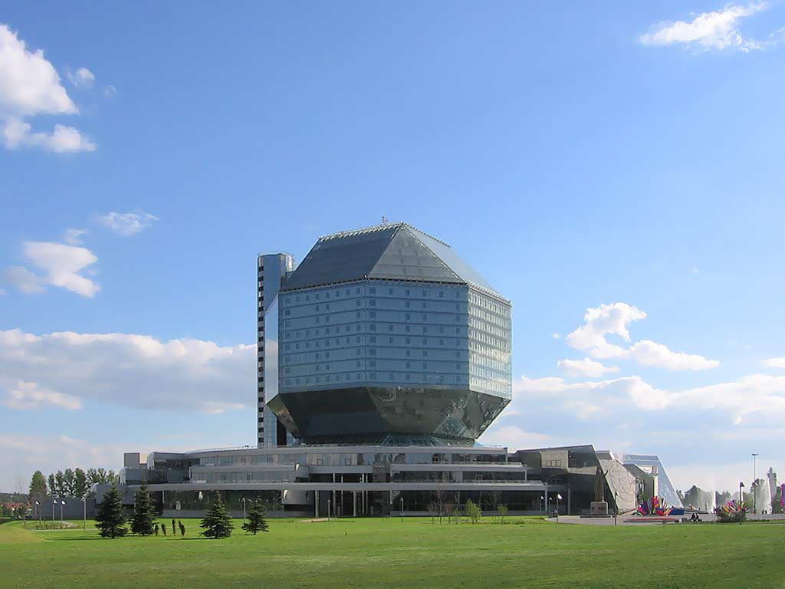
National system of education includes Preschool education, General secondary education / Special secondary education / Vocational education, Higher education, Postgraduate education.

Slide 5
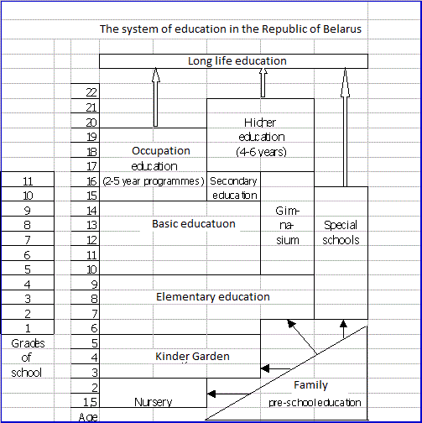

Slide 6
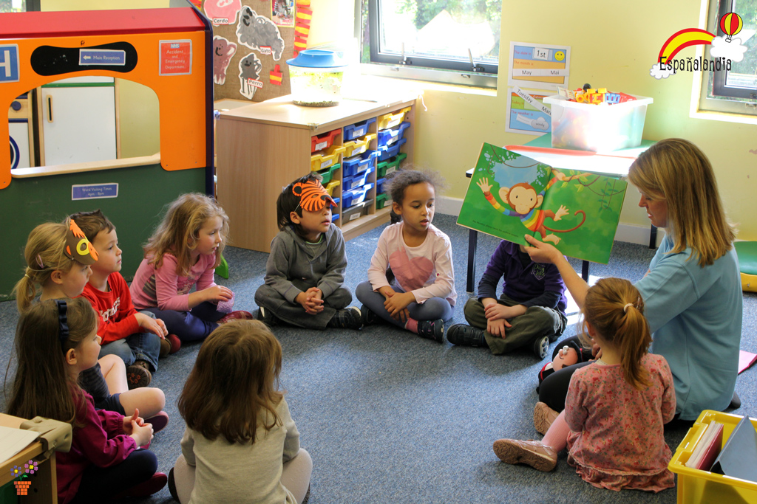
Pre-school education is not compulsory in Belarus but around 70% of children attend nursery or kindergarten before they start school.

Slide 7
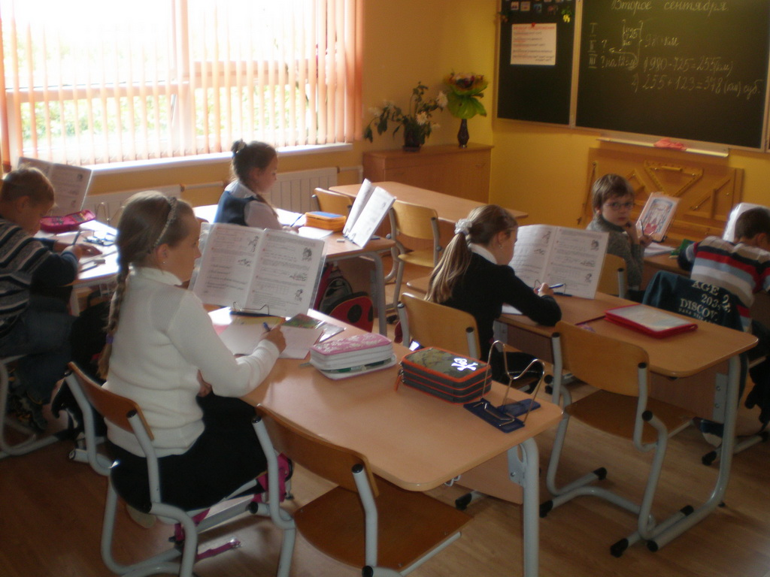
At primary school they learn to write, read; get fundamental knowledge of nature, society and man; learn principles of personal hygiene and healthy life style.

Slide 8
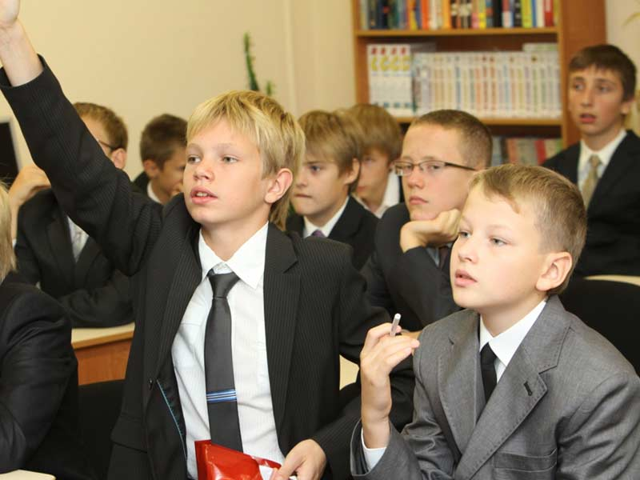
Most children in Belarus start school at the age of 6. Basic and secondary school provides general subjects, physical training and labour education. There is a 10-grade knowledge evaluation system.

Slide 9
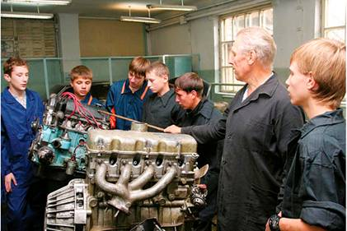
Vocational education establishments are involved in qualified labour training. They are more than 240 vocational schools, colleges, and vocational lyceums with more than 300 specialities.

Slide 10
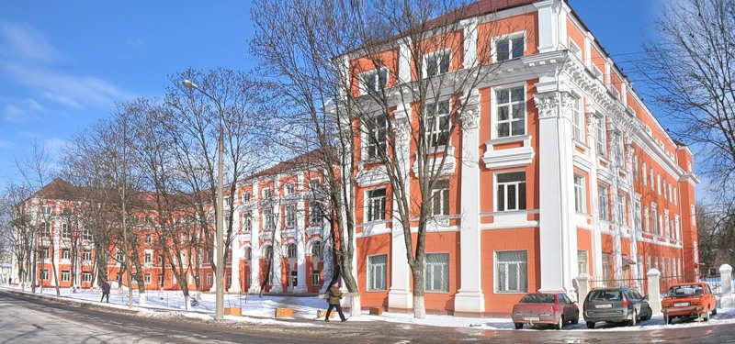
Belarus’ system of higher education comprises 57 state and private universities, academies, institutes, and higher colleges. These institutions offer day, night and extra-mural programs

Slide 11

Applicants are to have completed secondary education. Most entrance examinations are held in the form of centralized testing. Students who passed the exams but failed the competition pay tuition fees. Students who graduate with honours are awarded a so-called “red certificate”

Slide 12

Belarusian higher educational institutions traditionally confer the degree of Certified Specialist. It usually requires five years of training, success in final state examinations, and defense of a degree work (diploma)

