Slide 1
UNESCO
Презентация «UNESCO» подготовлена студентами
четвертого курса факультета иностранных языков
специальности «Английский язык» при изучении темы
«Европейские и всемирные международные организации» под руководством ст. преподавателя Гуд В.Г. . Данная творческая работа может быть в дальнейшем использована в ходе изучения дисциплины «Общественно-политический дискурс» студентами 4 курса ф-та иностранных языков при ознакомлении с темой «Международные организации и сообщества».

Slide 2
The United Nations Educational, Scientific and Cultural Organization is a specialized agency of the United Nations. Its purpose is to contribute to peace and security by promoting international collaboration through education, science, and culture in order to further universal respect for justice, the rule of law, and human rights along with fundamental freedom proclaimed in the United Nations Charter.

Slide 3
UNESCO has 195 member states and 9 associate members. UNESCO pursues its objectives through five major programs: education, natural sciences, social/human sciences, culture, and communication/information.

Slide 4
Projects sponsored by UNESCO include literacy, technical, and teacher-training programmes; international science programmes; the promotion of independent media and freedom of the press; regional and cultural history projects; the promotion of cultural diversity; translations of world literature; international cooperation agreements to secure the world cultural and natural heritage and to preserve human rights, and attempts to bridge the worldwide digital divide. It is also a member of the United Nations Development Group. UNESCO's aim is "to contribute to the building of peace, the eradication of poverty, sustainable development and intercultural dialogue through education, the sciences, culture, communication and information"

Slide 5
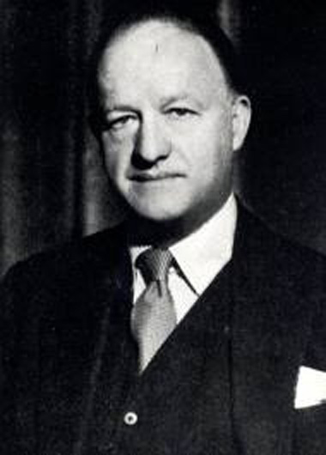
UNESCO and its mandate for international co-operation can be traced back to the League of Nations resolution on 21 September 1921. A prominent figure in the initiative for UNESCO was Rab Butler, the Minister of Education for the United Kingdom. At the ECO/CONF, the Constitution of UNESCO was introduced and signed by 37 countries, and a Preparatory Commission was established. The Preparatory Commission operated between 16 November 1945, and 4 November 1946—the date when UNESCO's Constitution came into force with the deposit of the twentieth ratification by a member state.

Slide 6
Education: UNESCO supports research in comparative education; and provides expertise and fosters partnerships to strengthen national educational leadership and the capacity of countries to offer quality education for all. This includes: UNESCO Chairs, an international network of 644 UNESCO Chairs, involving over 770 institutions in 126 countries. Environmental Conservation Organisation Convention against Discrimination in Education adopted in 1960 Organization of the International Conference on Adult Education (CONFINTEA) in an interval of 12 years Publication of the Education for All Global Monitoring Report

Slide 7
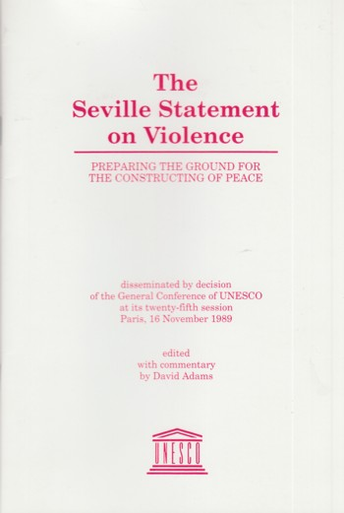
UNESCO also issues public 'statements' to educate the public: Seville Statement on Violence: A statement adopted by UNESCO in 1989 to refute the notion that humans are biologically predisposed to organised violence. Designating projects and places of cultural and scientific significance, such as: International Network of Geoparks Biosphere reserves, through the Programme on Man and the Biosphere (MAB), since 1971 City of Literature; in 2007, the first city to be given this title was Edinburgh, the site of Scotland's first circulating library. In 2008, Iowa City, Iowa became the City of Literature. Endangered languages and linguistic diversity projects Masterpieces of the Oral and Intangible Heritage of Humanity Memory of the World International Register, since 1997 Water resources management, through the International Hydrological Programme (IHP), since 1965 World Heritage Sites

Slide 8
Encouraging the "free flow of ideas by images and words" by: Promoting freedom of expression, Freedom of the press and Freedom of information legislation, through the International Programme for the Development of Communication and the Communication and Information Programme Promoting Pluralism and cultural diversity in the media Promoting events, such as: International Decade for the Promotion of a Culture of Peace and Non-Violence for the Children of the World: 2001–2010, proclaimed by the UN in 1998 World Press Freedom Day, 3 May each year, to promote freedom of expression and freedom of the press as a basic human right and as crucial components of any healthy, democratic and free society. International Literacy Day International Year for the Culture of Peace

Slide 9
Founding and funding projects, such as: Migration Museums Initiative: Promoting the establishment of museums for cultural dialogue with migrant populations. UNESCO-CEPES, the European Centre for Higher Education: established in 1972 in Bucharest, Romania, as a de-centralized office to promote international co-operation in higher education in Europe as well as Canada, USA and Israel. Higher Education in Europe is its official journal. Free Software Directory: since 1998 UNESCO and the Free Software Foundation have jointly funded this project cataloguing free software. FRESH Focussing Resources on Effective School Health. OANA, Organization of Asia-Pacific News Agencies International Council of Science UNESCO Goodwill Ambassadors

Slide 10
UNESCO enjoys official relations with 322 international non-governmental organizations (NGOs). Most of these are what UNESCO calls "operational", a select few are "formal". The highest form of affiliation to UNESCO is "formal associate", and the 22 NGOs with formal associate (ASC) relations occupying offices at UNESCO are: International Baccalaureate (IB) Education International (EI) International Council for Science (ICSU) International Council of Museums (ICOM) Union of International Associations (UIA)

Slide 11
Three bodies are responsible for policy-making, governance and day-to-day administration at the UNESCO: The General Conference, The Executive Board and The Secretariat. The General Conference is a gathering of the organisation’s member states and associate members, in which each state has one vote. Meeting every two years, it sets general policies and defines programme lines for the organization. The Executive Board’s members are elected by the General Conference for four-year team. The Executive Board prepares the session of the General Conference and ensures that its instructions are carried out. The Secretariat consists of the Director-General and his staff and is responsible for the day-to-day running of the organization.

Slide 12
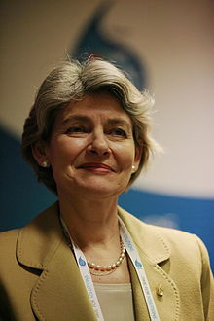
The list of the Directors-General of UNESCO since its establishment in 1946 is as follows: Julian Huxley (1946–1948) Jaime Torres Bodet (1948–1952) John Wilkinson Taylor (acting 1952–1953) Luther Evans (1953–1958) Vittorino Veronese (1958–1961) René Maheu (1961–1974; acting 1961) Amadou-Mahtar M'Bow (1974–1987) Federico Mayor Zaragoza (1987–1999) Koïchiro Matsuura(1999–2009) Irina Bokova (2009– )

